Slide 1
ShopEasy
SD6503 Testing and Secure Coding
DDL Team:
Frances Liu (PM)
Bowang Ding (Developer)
Diljot Singh (Tester)

Slide 2
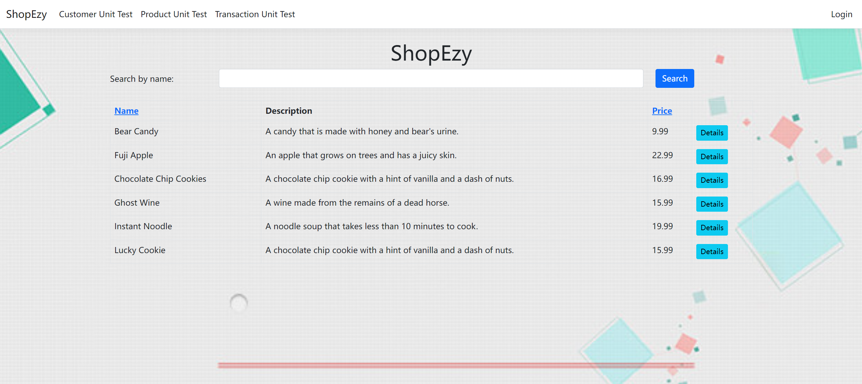
Application Overview
shopping web application with essential functions
user-centric e-commerce platform
browsing and shopping experiences for both guest users and registered customers

Slide 3
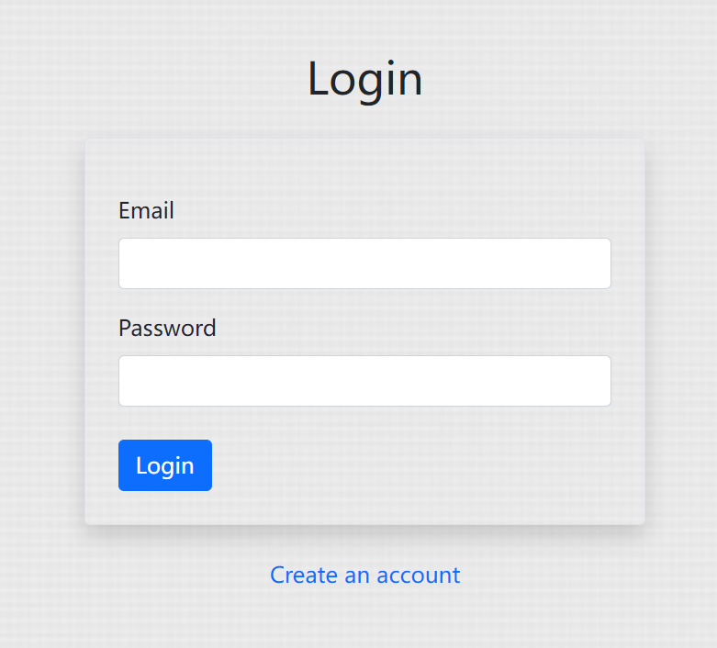
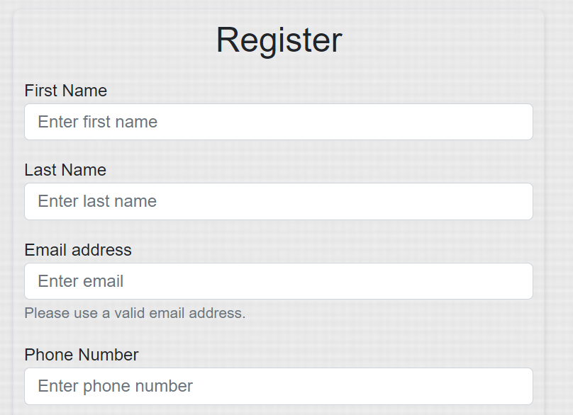
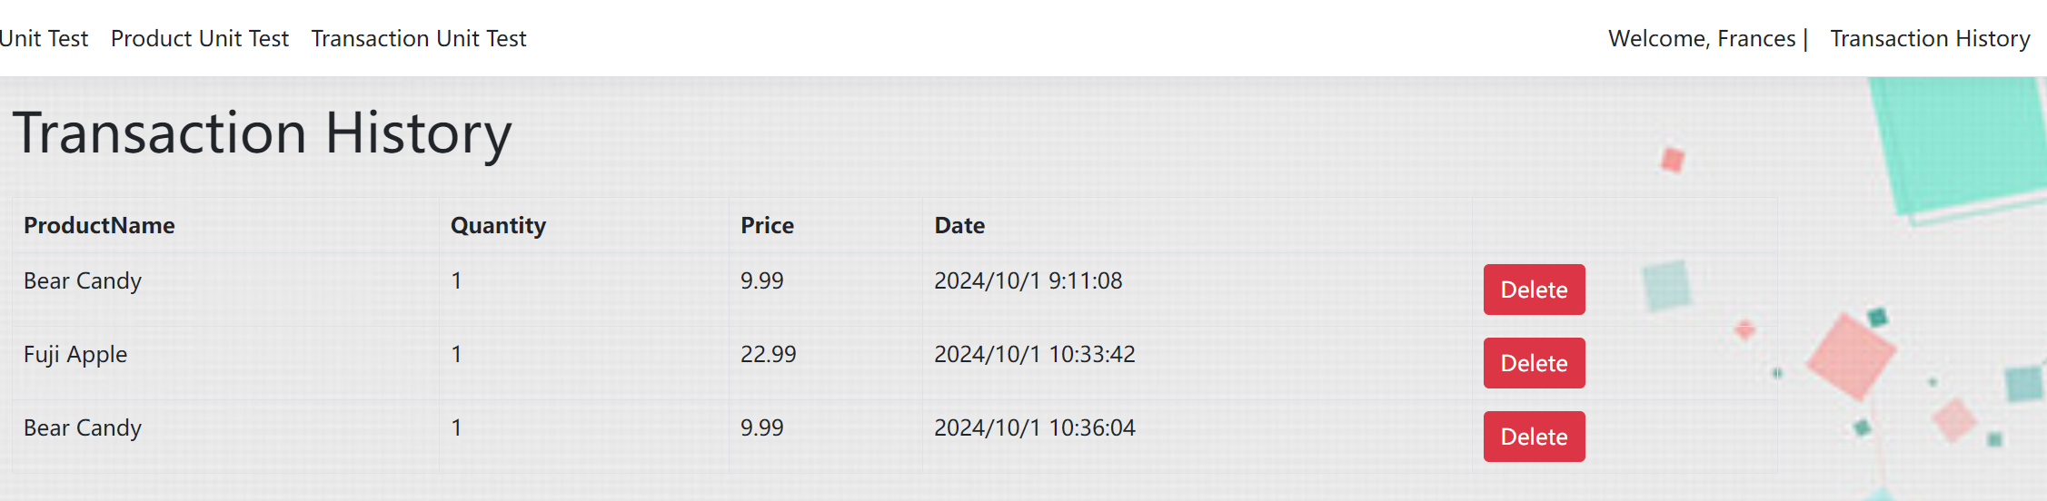

Slide 4
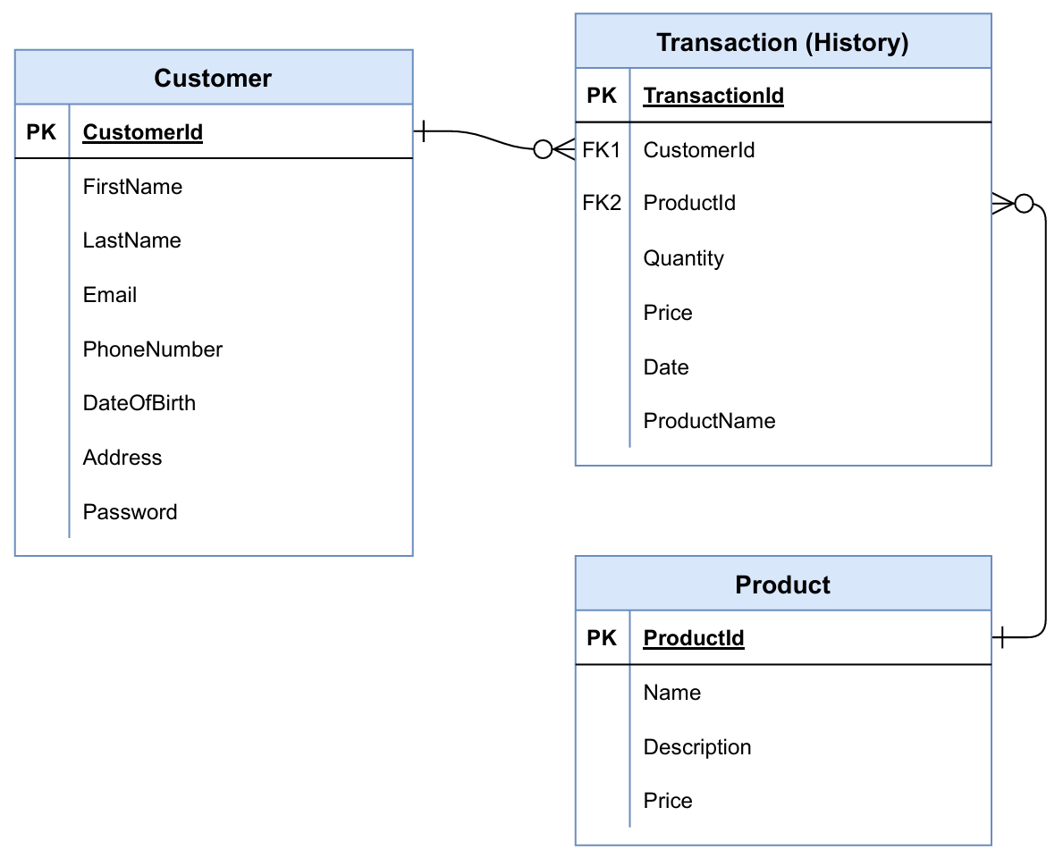
ERD

Slide 5
Features
Guest browsing
User Registration & login
Product viewing, searching, and sorting
Purchase
History (transaction management)

Slide 6
Sprints and Progress
Sprints | What was done in each sprint
Sprint 1 | User stories Test plan Most of the key features (Login function, Register function, Customer details edit function, Searching & Sorting function, Products displaying, View product details function)
Sprint 2 | The rest of the features (customer features, Transaction view feature, Transaction delete feature) Unit testing WBT BBT (partially)
Sprint 3 | Automation testing (Selenium) BBT (the rest) JMeter (performance and load test) ERD (Turn the rough sketch on paper into a more visually appealing image.)
Sprint 4 | Puma Scan (Static Code Analysis) Security document Presentation slides

Slide 7
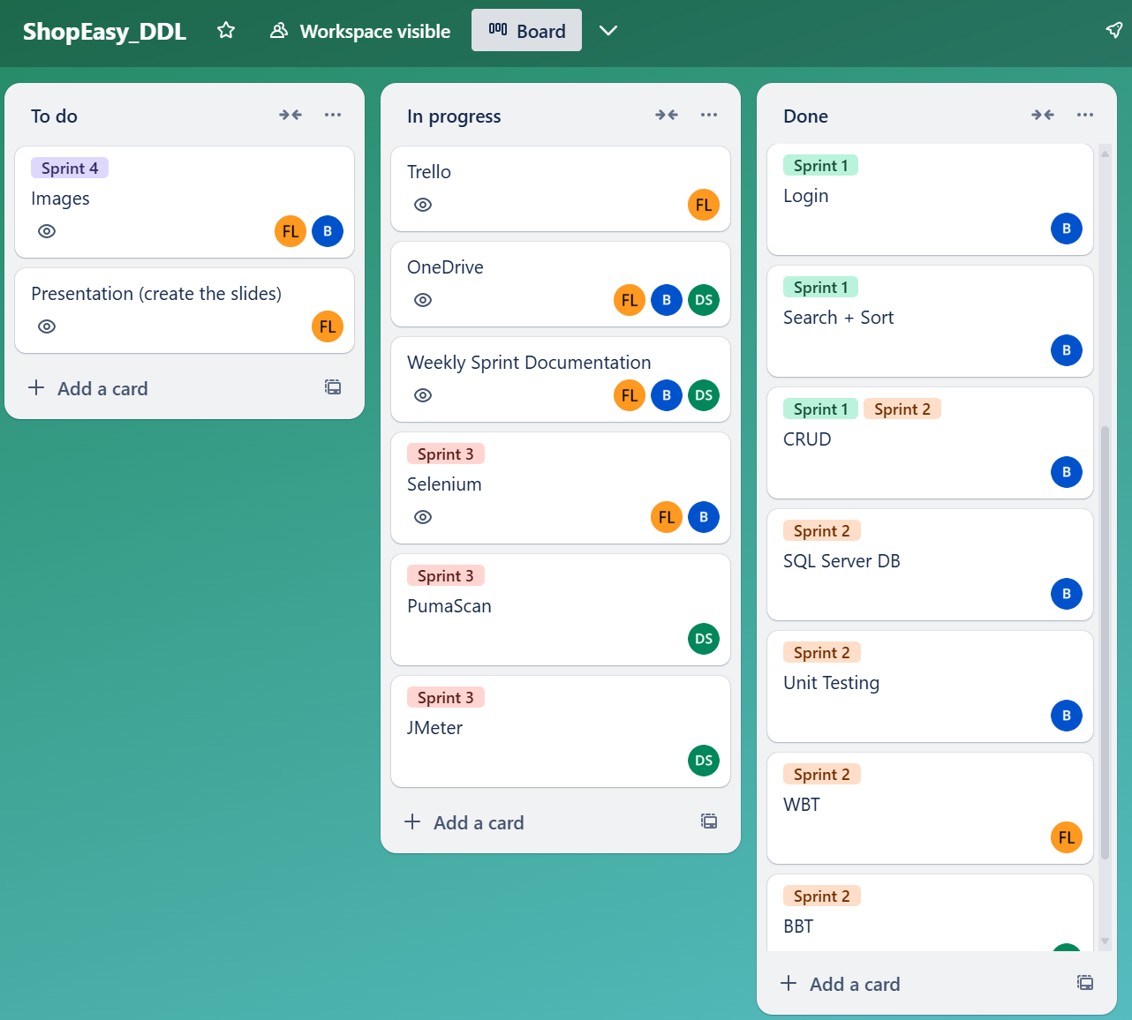
Sprints and Progress
Daily stand-up meeting
Weekly progress report to the tutor
Trello to monitor the whole project

Slide 8
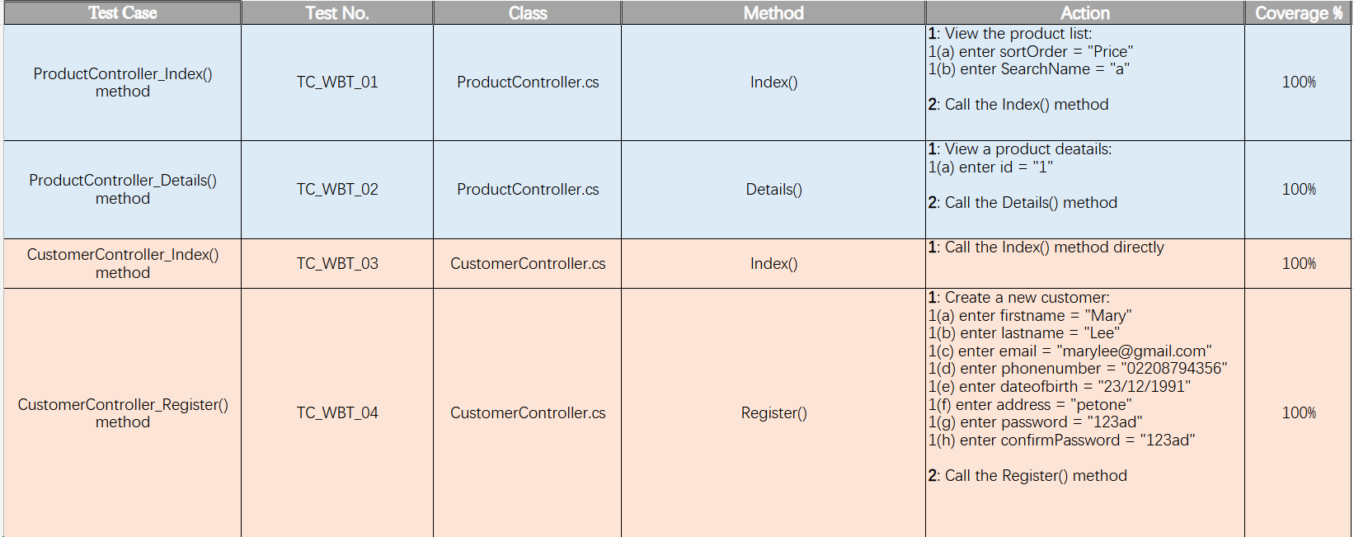
Testing - WBT
9 test cases, covered all controllers & all methods, achieved 100% coverage

Slide 9
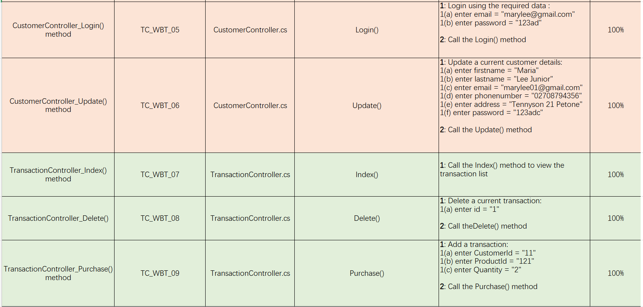
Testing - WBT
9 test cases, covered all controllers & all methods, achieved 100% coverage

Slide 10
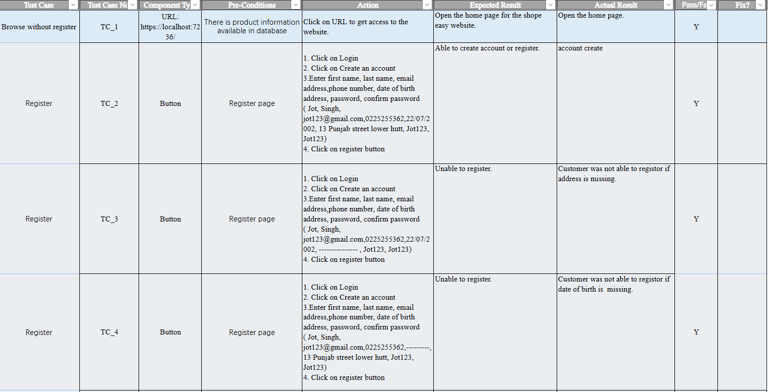
Testing - BBT
27 test cases, all passed, no bugs were found

Slide 11
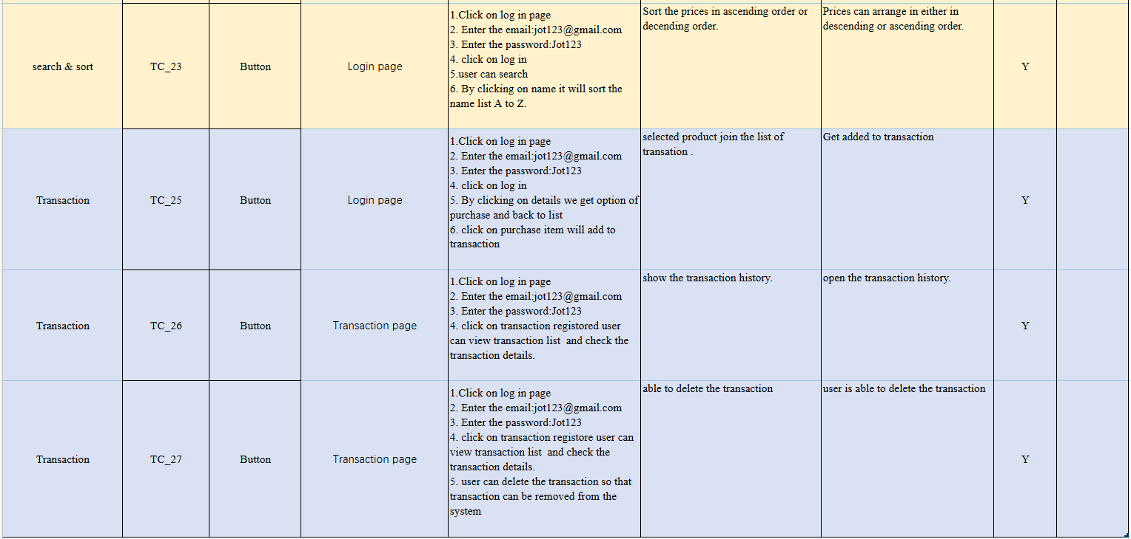
Testing - BBT
27 test cases, all passed, no bugs were found

Slide 12
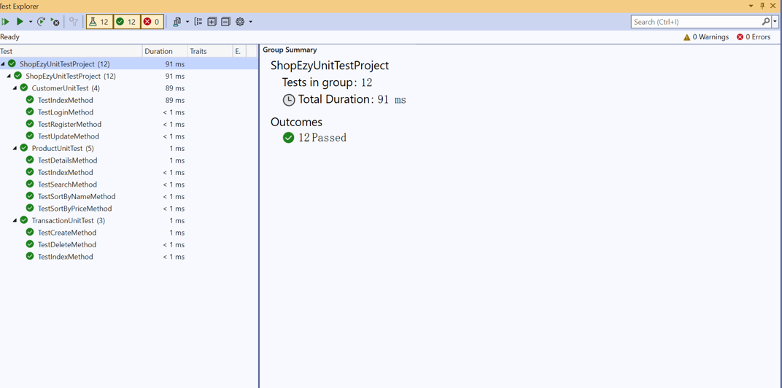
Testing - Unit Testing
12 test cases, covered all methods, all passed

Slide 13
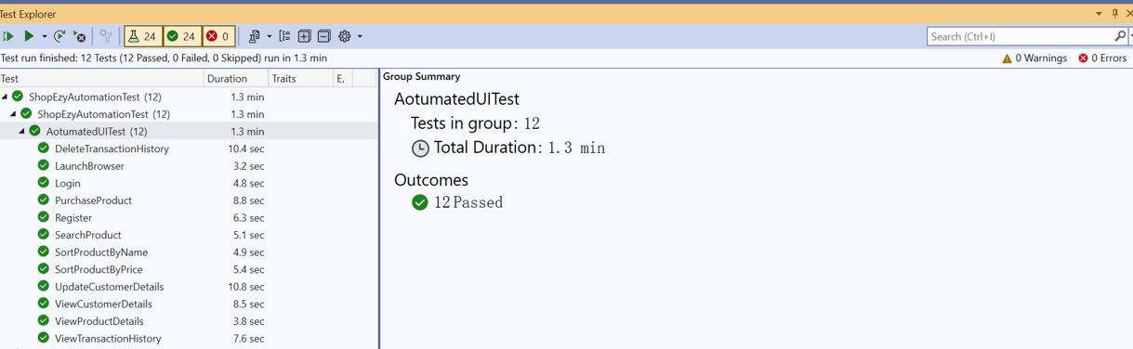
Testing – Automation Testing
12 test cases, covered all major functions, all passed

Slide 14
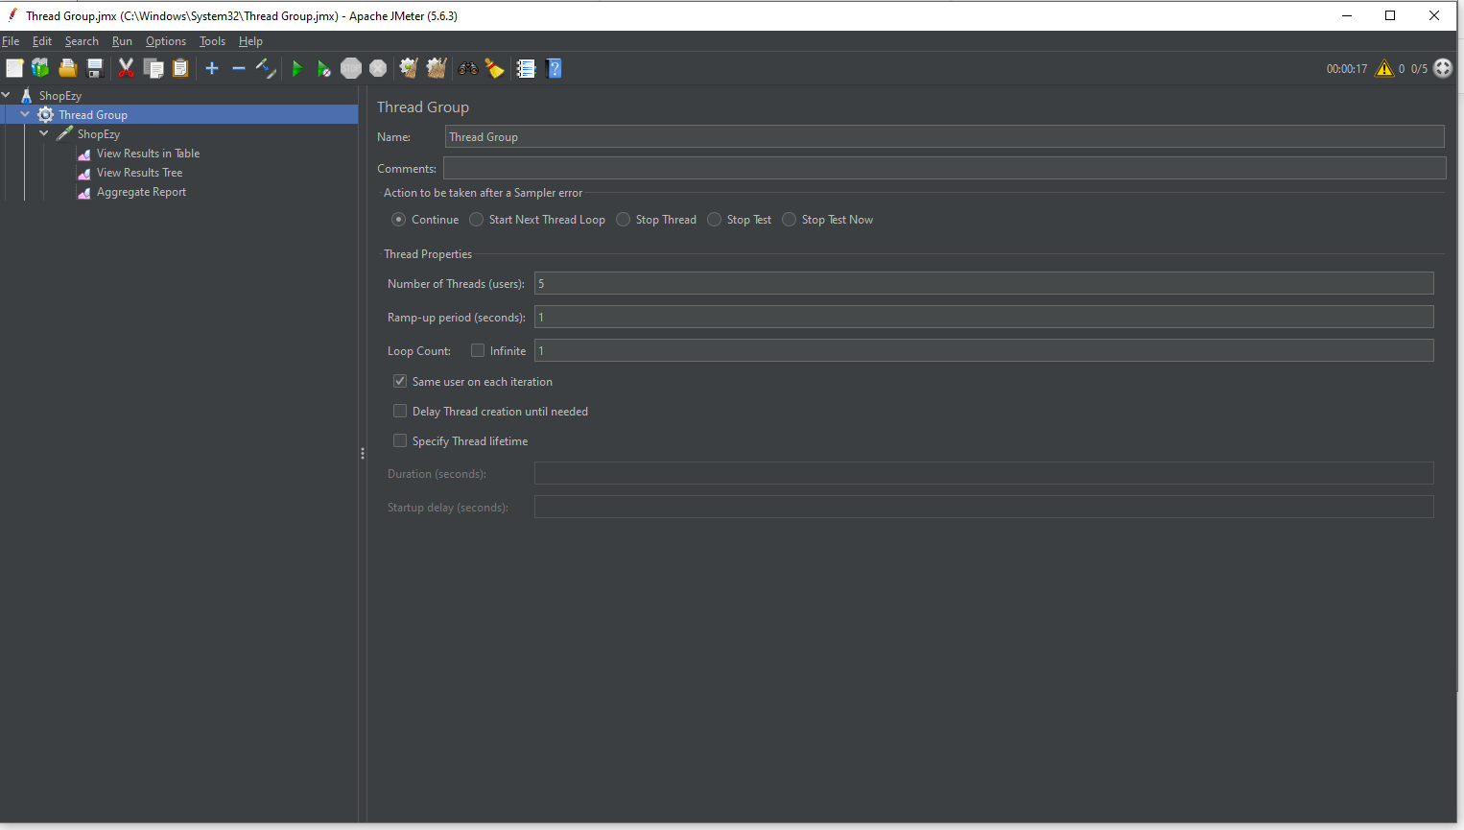
Testing - Performance and Load Testing (JMeter)

Slide 15
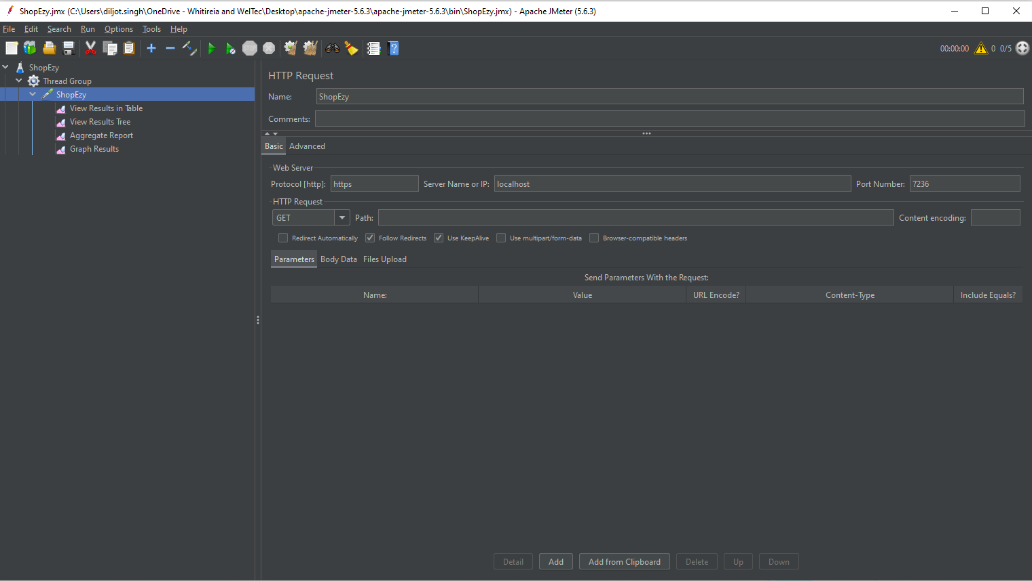

Slide 16
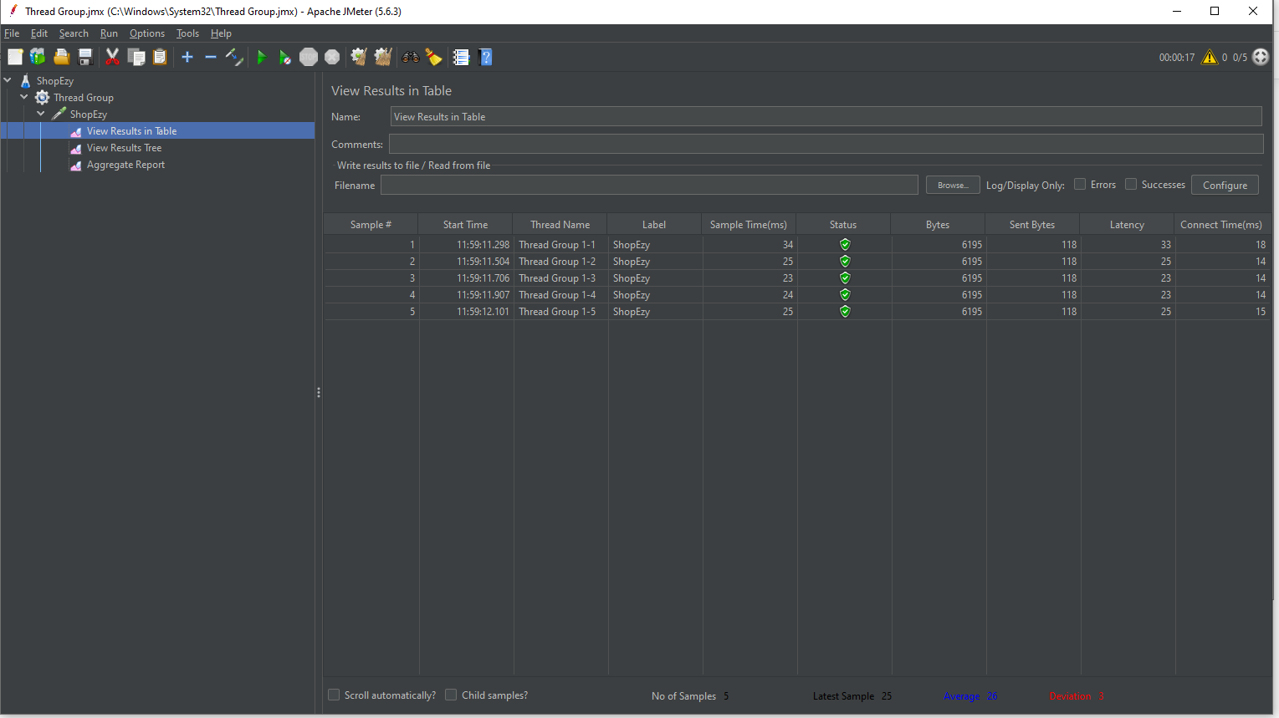

Slide 17
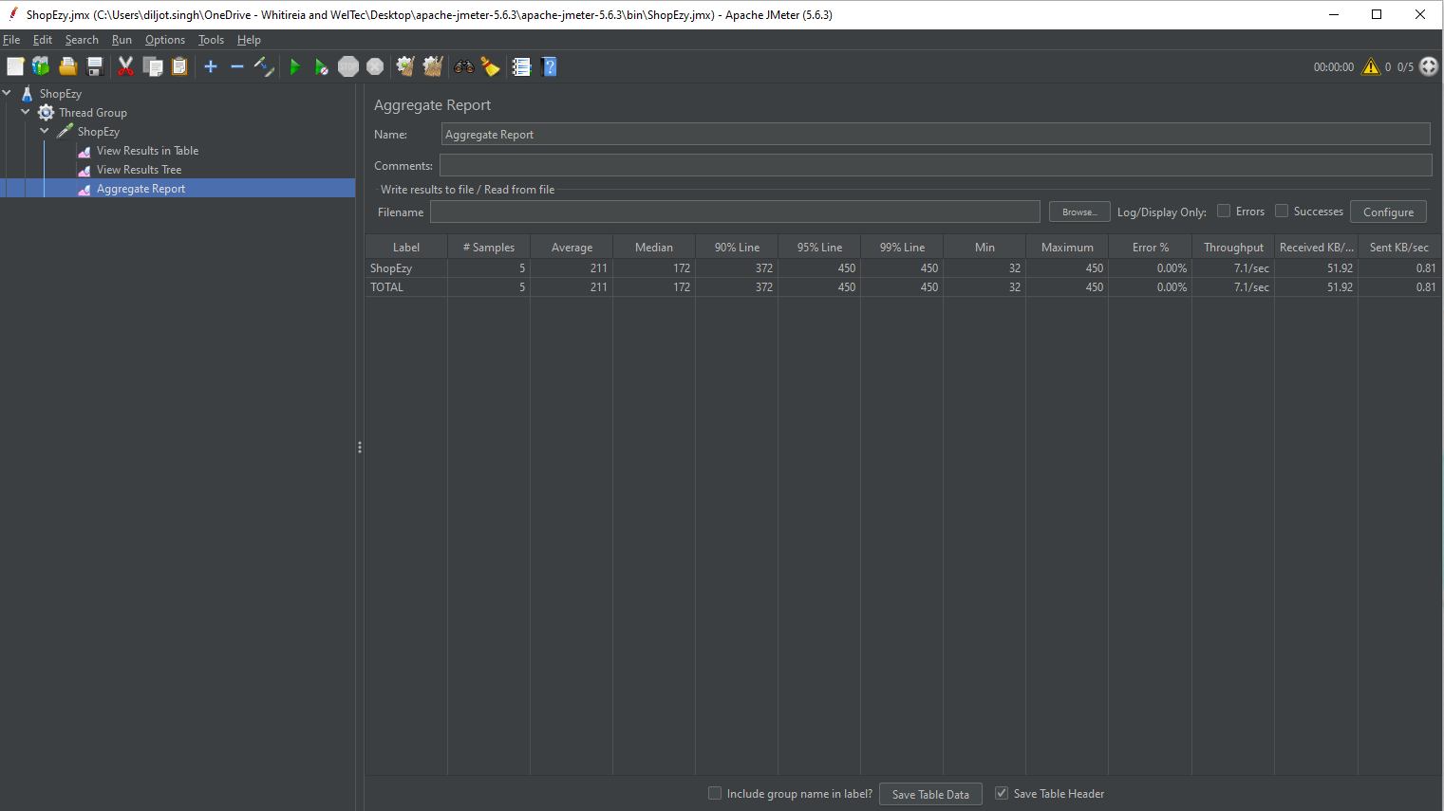

Slide 18

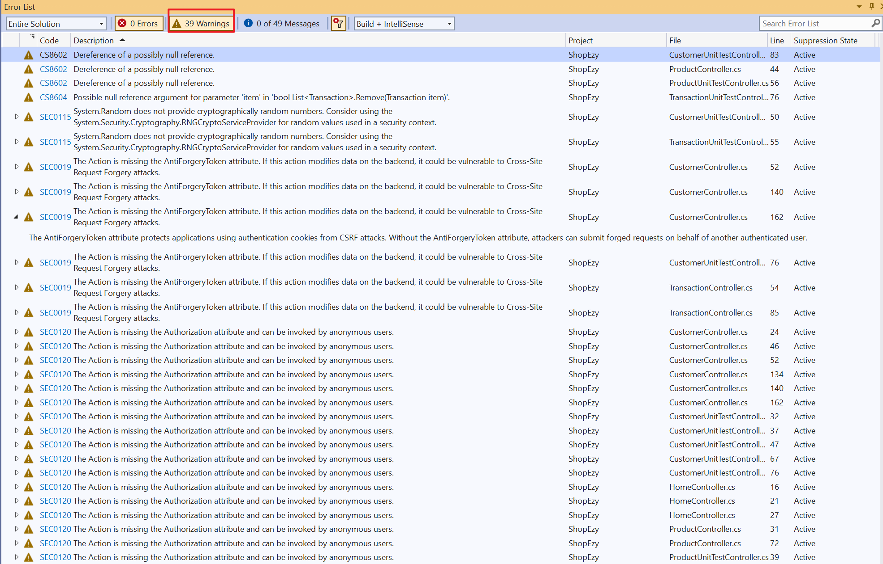
Testing - Puma Scan

Slide 19
Testing - Puma Scan
Vulnerabilities | Issue Type | What are they?
SEC0120 | access control | Missing Authorize Attribute It occurs when the application does not properly restrict the access to only the authorized users. This can lead to the high risk of unauthorized access to sensitive data.
SEC0019 | validation | Missing Anti Forgery Token Attribute It means missing CSRF protection, which will make the application vulnerable to CSRF attack.
SEC0115 | Insure/weak cryptography | Insecure Random Number Generator It occurs when a program uses a cryptographically insure random number generator, such as the System.Random.
CS8602 | Both involve null reference | Dereference of a possibly null reference It occurs when you try to access a variable, a method, or property which might be null. Thus, a NullReferenceException can be thrown and even the application can crash.
CS8604 |  | Possible null reference argument for parameter It occurs when you assign a potentially null value to a non-nullable variable. This can lead to a runtime error.

Slide 20
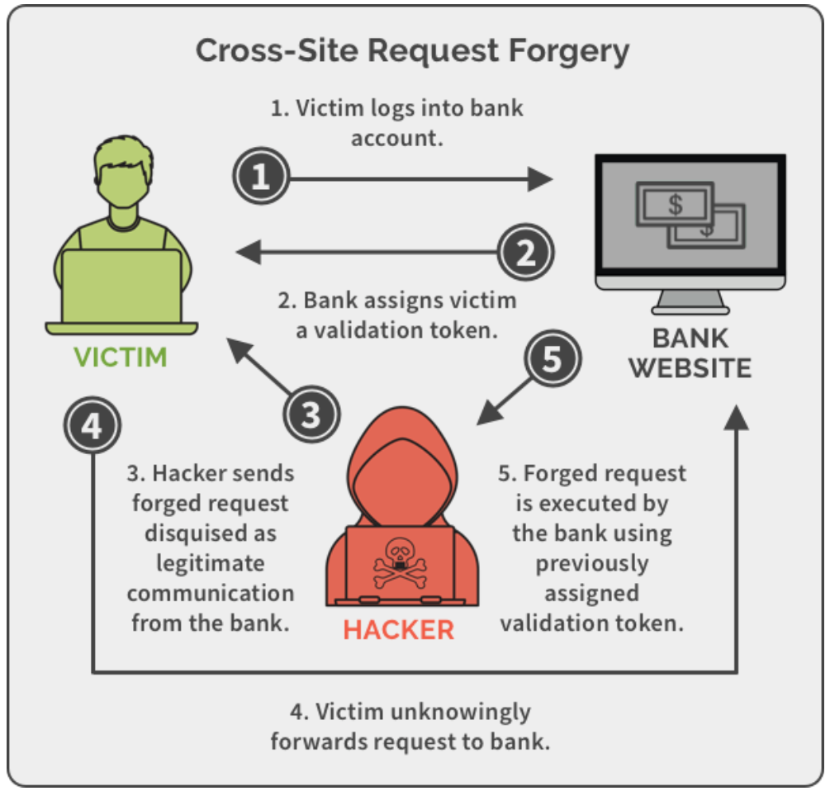
https://creativegroundtech.com/what-is-cross-site-request-forgery-csrf/
Notes:
Cross-Site Request Forgery (CSRF) attack: occurs when the user is using a trusted website, at the same time visits a malicious website unknowingly. Then the malicious website sends a fake request to the trusted website. The user’s valid authentication cookie from the trusted website is automatically included in the fake request, and the trusted website processes it and treats it as a valid but harmful action.

Slide 21
Potential Solutions to These Vulnerabilities
Vulnerabilities | Potential Solutions
SEC0120 Missing Authorize Attribute | Use Authorize attribute
SEC0019 Missing Anti Forgery Token Attribute | Use ValidateAntiForgeryToken attribute
SEC0115 Insecure Random Number Generator | Use system package like Security.Cryptography.RNGCryptoServiceProvider

Slide 22
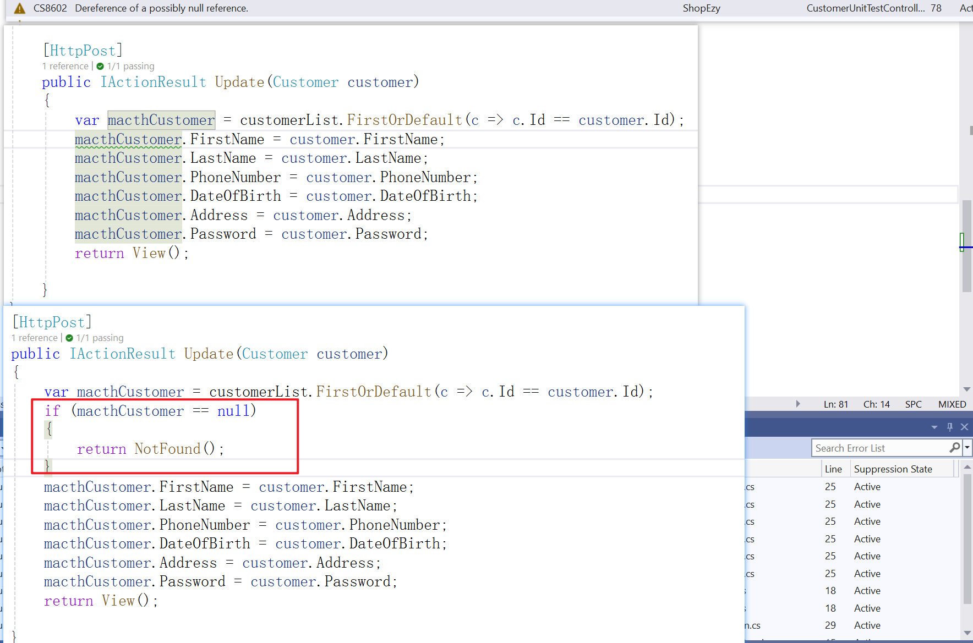
Two vulnerabilities were fixed in our code:
CS8602 Dereference of a possibly null reference
CS8604 Possible null reference argument for parameter

Slide 23
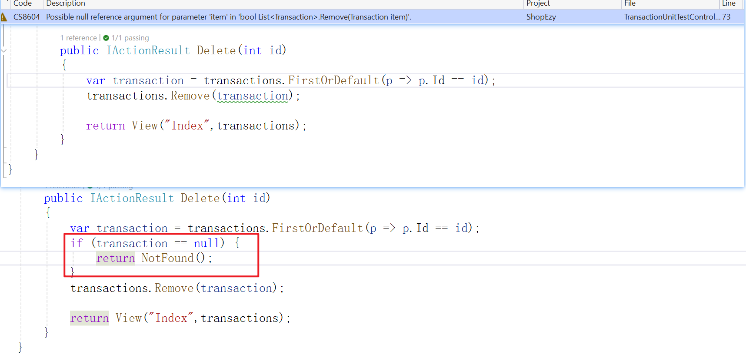
Two vulnerabilities were fixed in our code:
CS8602 Dereference of a possibly null reference
CS8604 Possible null reference argument for parameter

Slide 24
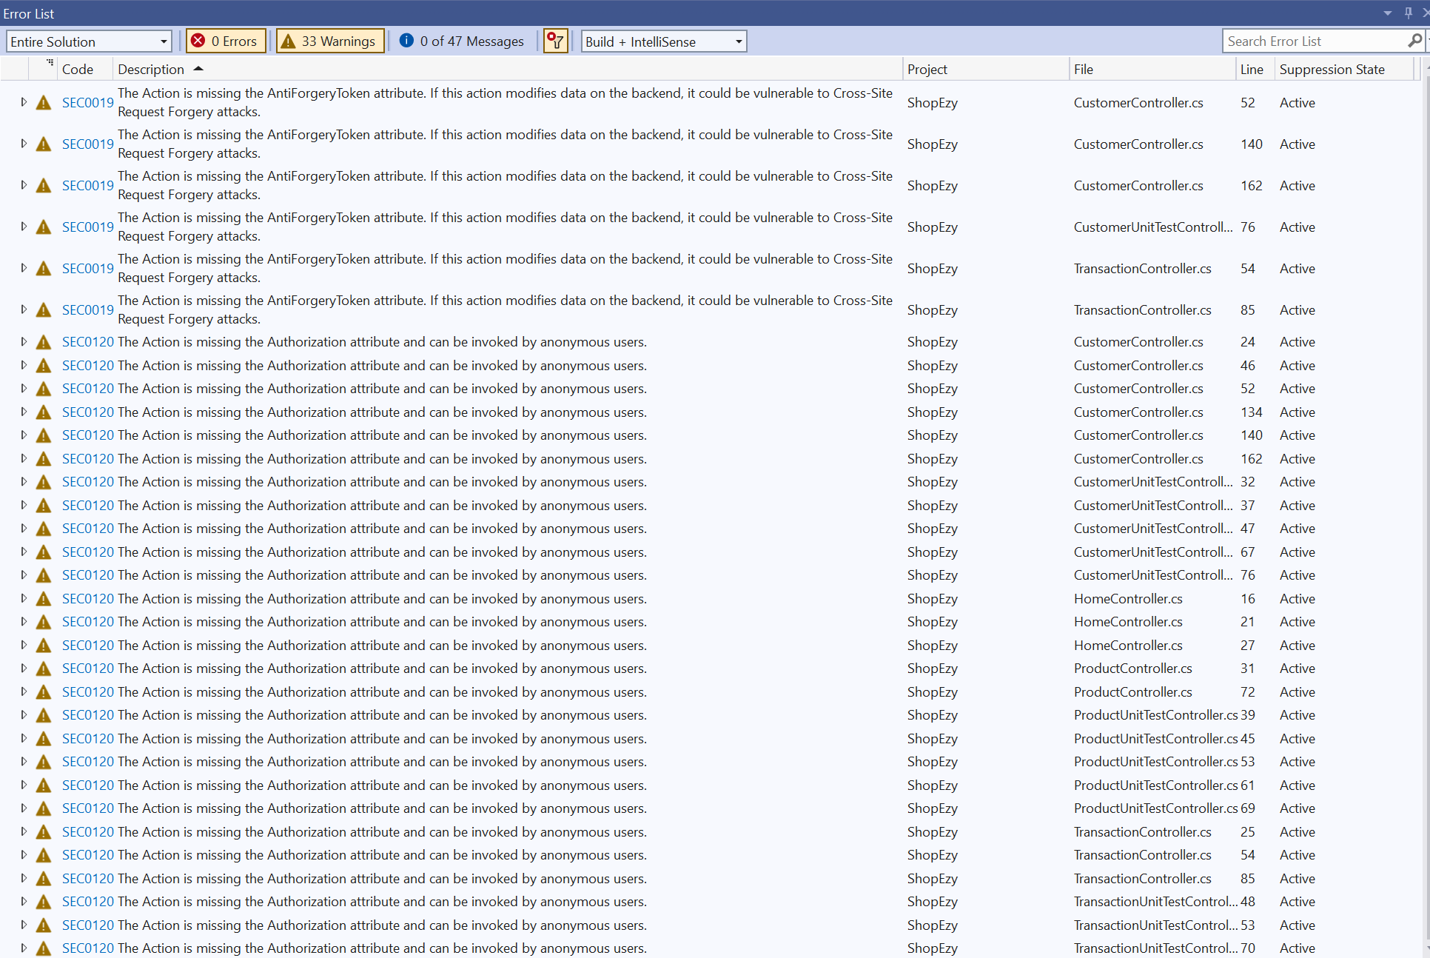
Testing - Puma Scan
39
33

Slide 25
Issues/Challenges faced
the use of new testing tools due to a lack of experience
JMeter usage: except test the home page, controllers also need to be tested.
Puma Scan is easy to use, but how the solve the discovered errors requires efforts.
Refer to course slides & videos
Ask help from Richa
Keep communication flowing smoothly within the team

Slide 26
Successes & Positive Outcomes
Well-defined user stories provided a clear roadmap
Core functions were completed on schedule
(A special thanks to our developer, Bowang.)
All four sprints were completed on time, with no major delays or obstacles
Great communication & effective collaboration within the team
Valuable experience on automation testing tool

Slide 27
THANK YOU

